Slide 1

Android Lesson 3: Changing Activities with Intent
By: Josh Chang
Notes:
Introduce yourself
Ask who has experience

Slide 2
Lesson’s Goal
Goal – Creating a new Shop Activity for us to buy upgrades in future lessons
What we need:
Main Activity
Button to take us to the shop
Shop Activity
Button to take us back to the main
TextView to display the points we have

Slide 3
Changing Views
Intent is Android’s way to signal your app that you want to change Activities.
Fragments on the other hand keep your app on the same Activity but you would be creating your own Fragment class that you can easily re-use in your Activities whenever you want.
We’re working with Intents

Slide 4
How To Use Intents

Slide 5
Intent and changing screens
Use the Intent class to allow us to change our activities
Intent i = new Intent(getApplicationContext(), NewActivity.class);
Create the intent, we have to give the Intent our new activity class
i.putExtra(“key”, “value”)
Allows us to store variables to pass around. Including all primitive types
startActivity(i)
Starts the process

Slide 6
Getting Passed Data
Data are saved in something called a Bundle. Here’s how to get the data:
Bundle extra = getIntent().getExtras();
Check if extra is null, otherwise you might crash if you don’t store any data
If (extra != null)
extra.getInts(“key”, “default”);
Similar to Shared Prefs, you have a key and you can store default values

Slide 7
Start Coding

Slide 8
Creating Our Shop Activity
To create a new Activity, right click the java folder with where your MainActivity.java is located and select new -> Java Class. We’ll call it ShopActivity
To create a layout, we’ll do the same in the res -> layout folder, select new -> Layout Resource file and call it activity_shop

Slide 9
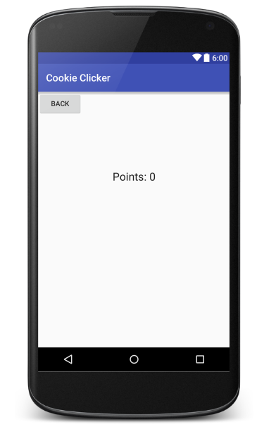
activity_shop.xml
<?xml version="1.0" encoding="utf-8"?> <RelativeLayout xmlns:android="http://schemas.android.com/apk/res/android" android:layout_width="match_parent" android:layout_height="match_parent"> <TextView android:layout_width="wrap_content" android:layout_height="wrap_content" android:textAppearance="?android:attr/textAppearanceLarge" android:text="Points: 0" android:id="@+id/tvShopPoints" android:layout_alignParentTop="true" android:layout_centerHorizontal="true" android:layout_marginTop="157dp" /> <Button android:layout_width="wrap_content" android:layout_height="wrap_content" android:text="Back" android:id="@+id/btnBack" android:onClick="backToMain" android:layout_alignParentTop="true" android:layout_alignParentLeft="true" android:layout_alignParentStart="true" /> </RelativeLayout>

Slide 10
ShopActivity.java
package net.joshchang.josh.cookieclicker; import android.content.Intent; import android.os.Bundle; import android.support.v7.app.AppCompatActivity; import android.view.View; import android.widget.Button; import android.widget.TextView; public class ShopActivity extends AppCompatActivity { private int points; private TextView tvPoints; protected void onCreate(Bundle savedInstanceState) { super.onCreate(savedInstanceState); setContentView(R.layout.activity_shop); // Get the data that our Intent passed in Bundle extra = getIntent().getExtras(); points = 0; // check if we received valid data if (extra != null) { // get the points that we stored or else get a default value of 0 points = extra.getInt("points", 0); } // Creates and set our TextView to show our points tvPoints = (TextView) findViewById(R.id.tvShopPoints); tvPoints.setText("Points: " + points); // Creates our back button to send us back to MainActivity Button back = (Button) findViewById(R.id.btnBack); } // brings us back to the main activity public void backToMain(View v) { Intent intent = new Intent(getApplicationContext(), MainActivity.class); startActivity(intent); } }

Slide 11
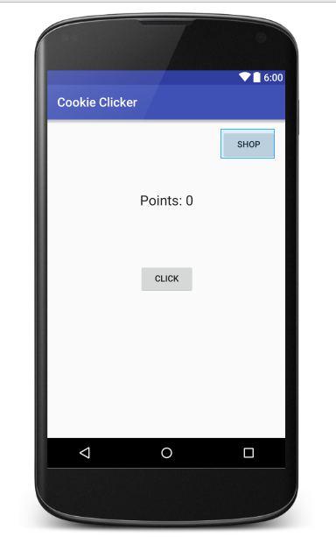
Acitivty_main.xml
<?xml version="1.0" encoding="utf-8"?> <RelativeLayout xmlns:android="http://schemas.android.com/apk/res/android" xmlns:tools="http://schemas.android.com/tools" android:layout_width="match_parent" android:layout_height="match_parent" android:paddingBottom="@dimen/activity_vertical_margin" android:paddingLeft="@dimen/activity_horizontal_margin" android:paddingRight="@dimen/activity_horizontal_margin" android:paddingTop="@dimen/activity_vertical_margin" tools:context="com.example.iamjo.cookieclicker.MainActivity"> <TextView android:layout_width="wrap_content" android:layout_height="wrap_content" android:textAppearance="?android:attr/textAppearanceLarge" android:text="Points: 0" android:id="@+id/tvPoints" android:layout_alignParentTop="true" android:layout_centerHorizontal="true" android:layout_marginTop="101dp" /> <Button android:layout_width="wrap_content" android:layout_height="wrap_content" android:text="Click" android:id="@+id/btnPoints" android:onClick="btnClick" android:layout_centerVertical="true" android:layout_centerHorizontal="true" /> <Button android:layout_width="wrap_content" android:layout_height="wrap_content" android:text="Shop" android:id="@+id/btnShop" android:onClick="shopButton" android:layout_alignParentTop="true" android:layout_alignParentRight="true" android:layout_alignParentEnd="true" /> </RelativeLayout>

Slide 12
MainActivity.java
public class MainActivity extends AppCompatActivity { private TextView tvPoints; private Button btn; private int points; private SharedPreferences pref; private Button store; // !!!! Change #1 // Hard-coded values to prevent confusion with variable types private final String PREF_NAME = "pref"; private final String POINTS = "totalPoints"; @Override protected void onCreate(Bundle savedInstanceState) { super.onCreate(savedInstanceState); setContentView(R.layout.activity_main); // Basic setup tvPoints = (TextView) findViewById(R.id.tvPoints); btn = (Button) findViewById(R.id.btnPoints); store = (Button) findViewById(R.id.btnShop); // !!!! Change #2 // Restoring data with pref pref = getSharedPreferences(PREF_NAME, Context.MODE_PRIVATE); // Get the points that we store in the pref. Otherwise the default value points = pref.getInt(POINTS, 0); // Sets the text tvPoints.setText("Score: " + points); } // opens the new ShopActivity public void shopButton(View v) { Intent intent = new Intent(getApplicationContext(), ShopActivity.class); intent.putExtra("points", points); startActivity(intent); } // Increment our points and displays it public void btnClick(View v) { points++; tvPoints.setText("Points: " + points); } // Same onPause method... // ... }
Full code at: https://github.com/chang47/AndroidTutorial/blob/master/Lesson3%20Intent/java/net/joshchang/josh/cookieclicker/MainActivity.java

Slide 13
Last thing!
Before we run our code we need to tell our app that ShopActivity exists, otherwise our app will crash.
To do we go to our AndroidManifest.xml and add a new activity:
<activity android:name=".ShopActivity"></activity>

Slide 14
Run Your App…

Slide 15
Now You’re an Activity Switching Ninja!

